Slide 1
Chamfer Matching
&
Hausdorff Distance
Presented by Ankur Datta
Slides Courtesy
Mark Bouts
Arasanathan Thayananthan

Slide 2
Hierarchical Chamfer Matching:
A Parametric Edge Matching Algorithm (HCMA)

Slide 3
Motivation
Matching is a key problem in vision
  Edge matching is robust.
HCMA is a mid-level features - edges
  robust

Slide 4
Types of matching
Direct use of pixel
  Correlation
Use low-level features
  Edges or corners
High-level matchers
  Use identified parts of objects
  Relations between features.

Slide 5
HCMA
Chamfer Matching - minimize a generalized distance between two sets of edge points.
  Parametric transformations
HCMA is embedded in a resolution pyramid.

Slide 6
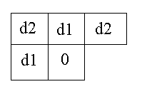
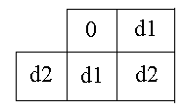
DT : Sequential Algorithm
  Start with zero-infinity image : set each edge pixel to 0 and each non-edge pixel to infinity.
  Make 2 passes over the image with a mask:
    1. Forward, from left to right and top to bottom
    2. Backward, from right to left and from bottom to top.
Forward Mask
Backward Mask
d1 and d2, are added to the pixel values in the distance map and the new value of the zero pixel is the minimum of the five sums.

Slide 7
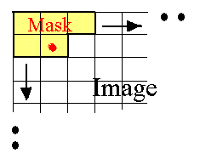
DT Parallel Algorithm
For each position of mask on image,
V_{i,j} = minimum(v_{i-1,j-1}+d2,v_{i-1,j} +d1,v_{i-,j+1}+d2,
v_{i,j-1}+d1,v_{i,j})

Slide 8
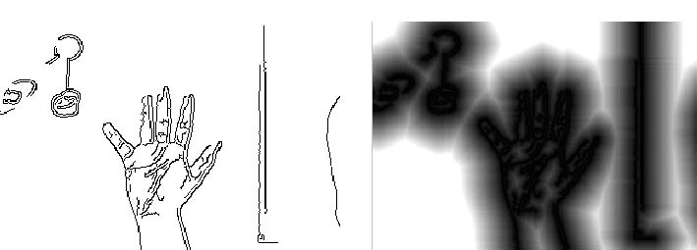
Distance Transform
(x,y)
(x,y)
d
d
Distance image gives the distance to the nearest edge at every pixel in the image
Calculated only once for each frame

Slide 9
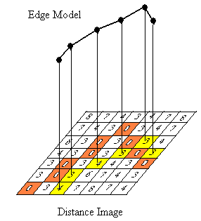
Chamfer Matching
Edge-model translated over Distance Image.
At each translation, edge model superimposed on distance image.
Average of distance values that edge model hits gives Chamfer Distance.
R.M.S. Chamfer Distance =
V_{i} = distance value, n = number of points
Chamfer Distance = 1.12

Slide 10
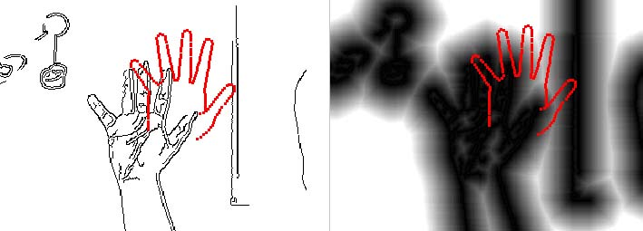
Chamfer Matching
Chamfer score is average nearest distance from template points to image points
Nearest distances are readily obtained from the distance image
Computationally inexpensive

Slide 11
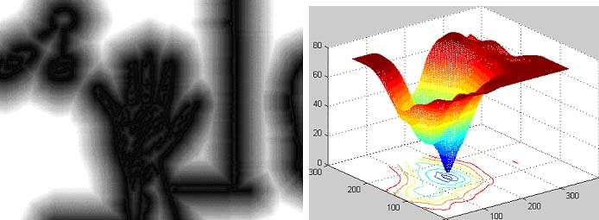
Chamfer Matching
Distance image provides a smooth cost function
Efficient searching techniques can be used to find correct template

Slide 12
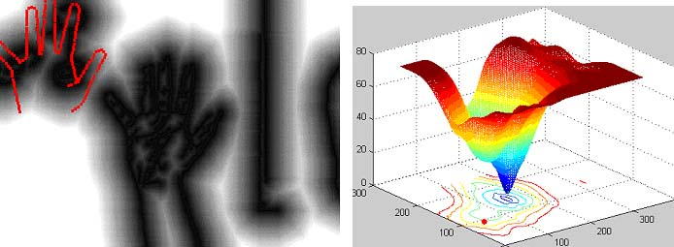
Chamfer Matching

Slide 13
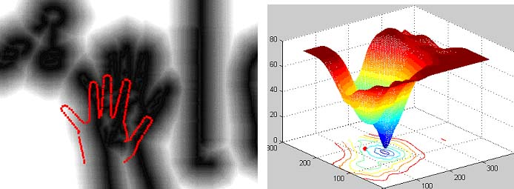
Chamfer Matching

Slide 14
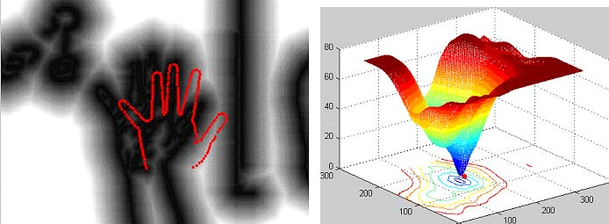
Chamfer Matching

Slide 15
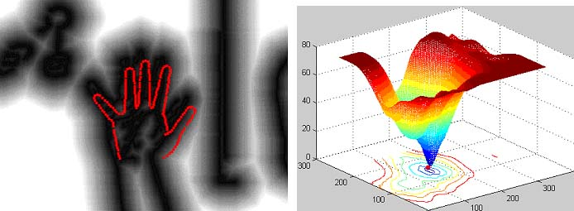
Chamfer Matching

Slide 16
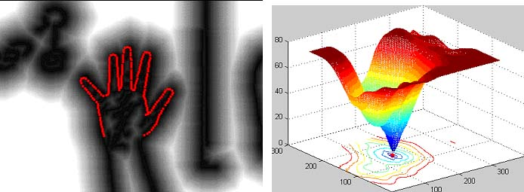
Chamfer Matching

Slide 17
Applications: Hand Detection
Initializing a hand model for tracking
  Locate the hand in the image
  Adapt model parameters
  No skin color information used
  Hand is open and roughly fronto-parallel

Slide 18
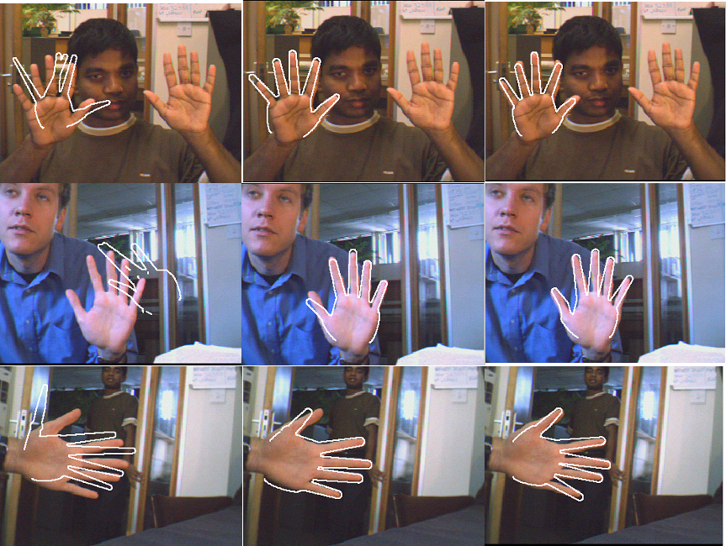
Results: Hand Detection
Shape Context with Continuity Constraint
Original Shape Context
Chamfer Matching

Slide 19
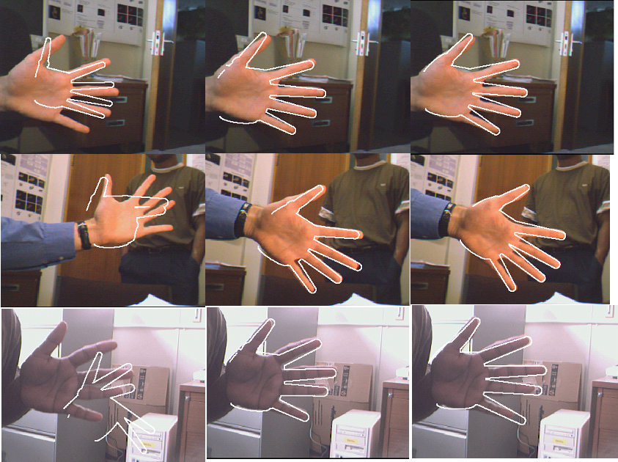
Results: Hand Detection
Shape Context with Continuity Constraint
Original Shape Context
Chamfer Matching

Slide 20
Discussion
Chamfer Matching
  Variant to scale and rotation
  Sensitive to small shape changes
  Need large number of template shapes
  But
  Robust to clutter
  Computationally cheap

Slide 21
Comparing Images Using the Hausdorff Distance

Slide 22
Introduction
Introduction
Hausdorff distance
HD translation
Comparing portions
HD grid points
HD rigid motion
examples
Matching a model to an image.
Main topic of the paper:
Computing the Hausdorff Distance under translation

Slide 23
Hausdorff distance
Introduction
Hausdorff distance
HD translation
Comparing portions
HD grid points
HD rigid motion
examples
set A = {a₁,….,a_{p}} and B = {b₁,….,b_{q}}
  Hausdorff distance
  Directed Hausdorff distance
h(A,B) ranks each point of A based on its nearest point of B and uses the most mismatched point

Slide 24
Minimal Hausdorff distance
Introduction
Hausdorff distance
HD translation
Comparing portions
HD grid points
HD rigid motion
examples
Considers the mismatch between all possible relative positions of two sets
Matching Criteria:
  Minimal Hausdorff Distance M_{G}

Slide 25
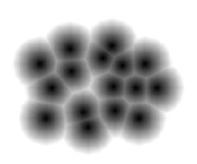
Voronoi surface
Introduction
Hausdorff distance
HD translation
Comparing portions
HD grid points
HD rigid motion
examples
It is a distance transform
It defines the distance from any point x to the nearest of source points of the set A or B

Slide 26
How to compute the M_{T}
Introduction
Hausdorff distance
HD translation
Comparing portions
HD grid points
HD rigid motion
examples
Again the HD definition
  We define
  Interested in the graph of d(x)
  which gives the distance from any point x to the nearest point in a set of source points in B

Slide 27
Computing the HD_{T}
Introduction
Hausdorff distance
HD translation
Comparing portions
HD grid points
HD rigid motion
examples
Can be rewritten as:
is the maximum of translated copies of d(x) and d’(x)
Define:
the upper envelope (pointwise maximum) of p copies of the function d(-t), which have been translated to each other by each

Slide 28
Comparing Portions of Shapes
Introduction
Hausdorff distance
HD translation
Comparing portions
HD grid points
HD rigid motion
examples
Extend the case to
Finding the best partial distance between a model set B and an image set A
Ranking based distance measure
K=

Slide 29
Comparing Portions of Shapes
Introduction
Hausdorff distance
HD translation
Comparing portions
HD grid points
HD rigid motion
examples
Target is to find the K points of the model set which are closest to the points of the image set.
‘Automatically’ select the K ‘best matching’ points of B
  It identifies subsets of the model of size K that minimizes the Hausdorff distance
  Don’t need to pre-specify which part of the model is being compared

Slide 30
Min HD for Grid Points
Introduction
Hausdorff distance
HD translation
Comparing portions
HD grid points
HD rigid motion
examples
Now we consider the sets A and B to be binary arrays A[k,l] and B[k,l]
F[x,y] is small at some translation when every point of the translated model array is near some point of the image array

Slide 31
Min HD for Grid Points
Introduction
Hausdorff distance
HD translation
Comparing portions
HD grid points
HD rigid motion
examples
Rasterization introduces a small error compared to the true distance
  Claim: F[x,y] differs from f(t) by at most 1 unit of quantization
The translation minimizing F[x,y] is not necessarily close to translation of f(t)
  So there may be more translation having the same minimum

Slide 32
Computing HD array F[x,y]
Introduction
Hausdorff distance
HD translation
Comparing portions
HD grid points
HD rigid motion
examples
can be viewed as the maximization of D’[x,y] shifted by each location where B[k,l] takes a nonzero value
Expensive computation!
  Constantly computing the new upper envelope

Slide 33
Computing HD array F[x,y]
Introduction
Hausdorff distance
HD translation
Comparing portions
HD grid points
HD rigid motion
examples
Probing the Voronoi surface of the image
Looks similar to binary correlation
  Due to no proximity notion is binary correlation more sensitive to pixel perturbation

Slide 34
HD under Rigid motion
Introduction
Hausdorff distance
HD translation
Comparing portions
HD grid points
HD rigid motion
examples
Extent the transformation set with rotation
  Minimum value of the HD under rigid (Euclidean) motion
Ensure that each consecutive rotation moves each point by at most 1 pixel
  So

Slide 35
Example translation
Introduction
Hausdorff distance
HD translation
Comparing portions
HD grid points
HD rigid motion
examples
Image
model
overlaid
Images Huttenlocher D. Comparing images using the Hausdorff distance

Slide 36
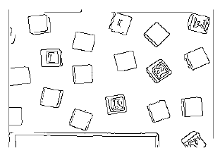
Example Rigid motion
Introduction
Hausdorff distance
HD translation
Comparing portions
HD grid points
HD rigid motion
examples
Image
model
overlaid
Images Huttenlocher D. Comparing images using the Hausdorff distance

Slide 37
Summary
Introduction
Hausdorff distance
HD translation
Comparing portions
HD grid points
HD rigid motion
examples
Hausdorff Distance
Minimal Hausdorff as a function of translation
  Computation using Voronoi surfaces
Compared portions of shapes and models
The minimal HD for grid points
  Computed the distance transform
  The minimal HD as a function of translation
  Comparing portions of shapes and models
The Hausdorff distance under rigid (euclidean) motion
Examples

Slide 38
END

Slide 39
Hausdorff distance
Introduction
Hausdorff distance
HD translation
Comparing portions
HD grid points
HD rigid motion
examples
Focus on 2D case
Measure the Hausdorff Distance for point sets and not for segments
HD is a metric over the set of all closed and bounded sets
  Restriction to finite point sets
  (all that is necessary for raster sensing devices)

Slide 40
HD under Rigid motion
Introduction
Hausdorff distance
HD translation
Comparing portions
HD grid points
HD rigid motion
examples
Computation
Limitations
  Only from the model B to the image A
  Complete shapes
Method
  For each translation
    Create an array Q in which each element =
      For each point in B
        For each rotation we probe the distance transform and maximize it with values already in the array

Slide 41
Distance Transform
DT’s are global transformations.
Reduce computational complexity : consider edge-pixels in immediate neighbourhood of edge pixels (local transform).
DT at a pixel can be deduced from the values at its neighbors.

Slide 42
Matching portions of shapes
Introduction
Hausdorff distance
HD translation
Comparing portions
HD grid points
HD rigid motion
examples
Matching portions of the image and a model
  Partial distance formulation is not ideal!
  Consider portion of the image to the model
  More wise to only consider those points of the image that are ‘underneath’ the model

Slide 43
Conclusion
Chamfer matching is better when
  There is substantial clutter
  All expected shape variations are well-represented by the shape templates
  Robustness and speed are more important

